Slide 1




بسم الله الرحمن الرحيم
PHARMACEUTICAL ANALYSIS
AND
DRUG QUALITY CONTROL
PH483 Lecture # 8 07-03-2021
DR. Badr M. Al-Hadiya

Slide 2
مواضيع محاضرة اليوم
- Assay of Bulk and Pharmaceutical Preparation
فحص المواد السائبة والمستحضرات الصيدلانية
- Stability Indicating Method of Analysis
طريقة التحليل التي تشير إلى الاستقرار
- Analytical Chemistry Problems and Solving Skills
مشاكل تحليلية وحلول مهارية

Slide 3
Background
As mentioned in previous lecture:
- Assay means:
1 : examination and determination as to characteristics (such as weight, measure, or quality)
2 : analysis (as of an ore or drug) to determine the presence, absence, or quantity of one or more components also : a test used in this analysis.
- Diagnostic assay means:
1. diagnostic assay - an assay conducted for diagnostic purposes.
2. diagnostic test assay - a quantitative or qualitative test of a substance (especially an ore or a drug) to determine its components; frequently used to test for the presence or concentration of infectious agents or antibodies etc.
- Assay validation provides an assurance of reliability during normal use, and is sometime referred to as "the process of providing documented evidence that the method does what it is intended to do." Assay Validation Levels and Steps.

Slide 4
List of Analytical Skills
a good example of analytical skills, includes:
Research.
Forecasting.
Problem-solving.
Data mining.
Data and metrics interpreting.
Reporting.
Organization.
Communication.

Slide 5
What is the difference between purity and assay?
The main difference between assay and purity is that an assay is the determination of one of the main component in a sample whereas purity is the determination of impurities in a sample. ... Assay and purity are two types of measurements used to determine the components of a sample.
How do you calculate purity?
Percentage purity of a substance can be calculated by dividing the mass of the pure chemical by the total mass of the sample, and then multiplying this number by 100.
How do you determine the purity of a substance?
Melting and Boiling Point Determination
The physical properties of a substance can be used to establish its purity. These properties include the melting point and boiling point. Different substances tend to have different melting and boiling points, and any pure substance will have a specific melting and boiling point.

Slide 6
What is purity and potency?
potency often means the amount of the desired compound in the sample: when you weigh 100 mg of a standard with 90% potency, there's only 90 mg of the targeted compound in there. in most cases, purity = chemical purity. that is, percentage of the target compound as determined by the primary method.
How do you calculate the purity of a working standard?
The purity of the standard is calculated to 95.55% (purity = 100% – (2.5% x 0.98) – 2%).

Slide 7
Assay of Bulk and Pharmaceutical Preparation
BACKGROUND: In the field of drug analysis, the analytical investigation of bulk drug materials, the intermediates in their synthesis, products of drug research, drug formulations, impurities and degradation products, and biological samples containing the drugs and their metabolites is a very important area in contributing to high quality, maximal efficacy, and safety of drug therapy, as also maximum economy during drug production. From the point of view of public health, the safety, efficacy, financial and economy of drug therapy are extremely important issues. For that reason, pharmaceutical and biomedical analyses are among the most important branches of applied analytical chemistry. Also, Drug discovery requires a solid analytical background, with a great variety of methods to be used.

Slide 8
The importance of drug impurity and stability-related issues has also been characterized by a number of books and articles devoted to this assay subject. The determination of drugs and metabolites in biological samples, with particular attention to toxicological and forensic analysis, requires special techniques and a special manner of thinking, as reflected by many books and articles on these issues.
Assay: An assay is an analysis done to determine: The presence of a substance and the amount of that substance. Thus, an assay may be done for example to determine the level of thyroid hormones in the blood of a person suspected of being hypothyroid (or hyperthyroid).

Slide 9
Why assay is performed in pharmaceutical industry?
An assay is a process of analyzing a substance to determine its composition or quality. The term is often used in the mining industry to refer to tests of ore or minerals. The term assay is also used in the environmental, chemical and pharmaceutical industries. Assaying is also important in futures markets.
Assays based on HPLC are very commonly used to measure the quality of drugs and, according to ICH, certain parameters must be checked to validate the analytical method: linearity, specificity, accuracy, precision (inter and intraday), limit of detection (LOD), limit of quantitation (LOQ) and robustness (ICH-Q2B, 2005).

Slide 10
How is assay calculated?
Difference Between PURITY, ASSAY & POTENCY
On as is basis = (Area of sample / Area of standard) x (conc. of standard / conc. of sample) x potency or assay of standard.
On anhydrous basis = (Assay on as is basis / 100 – moisture) x 100.
On dried basis = (Assay on as is basis / 100 – LOD) x 100.
Why assay is more than 100?
HPLC assay higher than 100%
If your values are much higher than 100%, such as 110%, then the reason very likely is that your standard and your samples are not the same. In other words the purity of your standard is less than 100%, or lower than stated in the certificate of analysis.

Slide 11
What is an assay method?
Validation methods are completed to ensure that an analytical methodology is accurate, specific, reproducible and rugged over
the specified range that a target analyte will be analyzed.
Is recalculation an analytical procedure?
Typically, there are five audit procedures that normally use by auditors to obtain audit evidence. Those five audit procedures include Analytical review, inquiry, observation, inspection, and recalculation.

Slide 12
Techniques For pharmaceutical and biomedical analyses
- Application of Chromatographic Techniques, including:
- Various forms of high-performance liquid chromatography (HPLC are becoming undoubtedly the most important methods, solve no less than 50% of the problems, leaving the other 50% to about 15 other chromatographic methods).
- Ultra performance liquid chromatography (UPLC).
- HPLC coupled with mass spectrometry, LC/MS.
- Application of Chromatographic Techniques, including:
- Spectroscopic Methods (such as IR spectroscopy).
- Mass Spectrometry (MS).
- Ultraviolet (UV) Visible (Vis) Spectrophotometry.
- Gas Chromatography (GC).
- Thin-layer Chromatography (TLC).
- Other Electroanalytical Methods (such as, Application of Capillary Electrophoresis)
- Applications of titration methods.
Figure of Some Analytical Instruments shown on Next Slide:

Slide 13
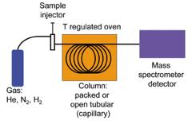
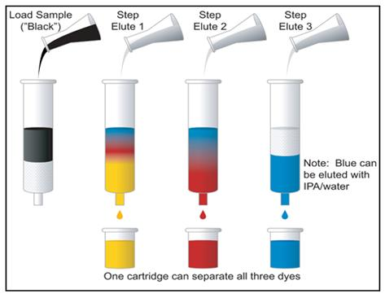
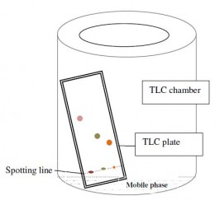
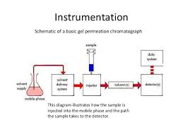
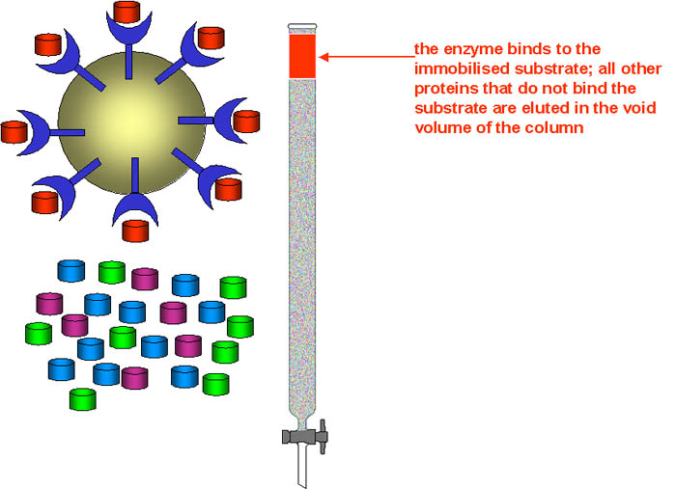
HPLC | GC | COLUMN CHROMATOGRAPHY
AFFINITY CHROMATOGRAPHY (AC) | Thin Layer Chromatography (TLC) | Schematic of Gel Permeation Chromatograph

Slide 14
FUTURE TRENDS الاتجاهات المستقبلية
Globalization of the drug market and competence among the drug companies has caused pharmaceutical analysis to become one of the battle-fields in the struggle. The importance of issues related to drug safety has greatly increased and this has led to the continual increase of demands with regard to securing the quality of drugs, and often over securing the safety of drug therapy.
Historical Steps in the demands and analytical strategies:
The first step was the establishment in the European Pharmacopoeia, of which the Sixth Edition is now official. This became the basis of the national pharmacopoeias of the member states of the European Union.

Slide 15
The next step was the formation of ICH (International Conference on Harmonization), which was done with the aim of harmonizing the efforts of registration agencies, principal pharmacopoeias (Ph. Eur., USP, and Japanese Pharmacopoeia), and pharmaceutical manufacturers’ organizations, to improve the quality of drugs and the safety and efficacy of drug therapy.
The tendencies toward globalization and harmonization and the necessity of increasing the safety of drug therapy, have prompted the validation of analytical methods to the fore-front; moreover, it has become one of the most important issues in contemporary معاصر drug analysis. However, some negative tendencies are also apparent:

Slide 16
A fully validated method meeting the requirements of various guidelines needs much more analytical data than would be strictly necessary
Many drug analysts, especially among the young generation, feel that the essence of pharmaceutical analysis is the mass production and handling of data, rather than problem solving
The way of thinking is changing, with many people, mainly outside the circles of drug analysts, believing that possession of up-to-date, automated / computerized instruments and validated methods automatically give good and reliable results. Pharmaceutical analysis is an important field of activity in the interest of suffering mankind, through increasing the safety of drug therapy.

Slide 17
Stability-Indicating Method of Analysis
Stability studies are generally performed on pharmaceutical products, food and other products problems, as well as ingredients in each to evaluate how they are affected by external factors such as light, heat, humidity, temperature, stress, etc. in an effort to determine how these factors influence the drug. This testing helps determine the shelf life of the product along with storage guidelines which are imperative for consumer safety. Two common types of stability tests are real-time and accelerated.
Real-time tests are accomplished by storing pharmaceutical products according to the recommended conditions and checking or monitoring the product until it fails. The products are tested at 3, 6, 9, and 12 months for the first year, twice a year the second, and once a year for each year thereafter until the product fails to meet specifications and safety standards.

Slide 18
Accelerated stability studies require products being stored in fabricated environments where different factors such as light, or heat are accelerated to determine when the product fails. By performing accelerated studies, degradation can be predicted.
Stability testing can also be performed on containers, closures, or other packaging.
A Stability-indicating assay method can be defined as “Validated quantitative analytical method that can detect the change with time in the chemical, physical or microbiological properties of the drug substance and drug products are specific so that the content of active ingredients and degradation products can be accurately measured without interference”

Slide 19
What is the purpose of stability testing?
The purpose of stability testing is to provide evidence on how the quality of a drug substance or drug product varies with time under the influence of a variety of environmental factors, such as temperature, humidity, and light, and to establish a retest period for the drug substance or a shelf life for the drug ...
What is a stability indicating method?
According to an FDA guidance document, a stability-indicating method is a validated quantitative analytical procedure that can be used to detect how the stability of the drug substances and drug products changes with time.
What are stability indicating parameters?
Stability indicating parameters
Requirement: For stability-indicating parameters such as related substances and microbial limits, testing will be performed at release and shelf-life during stability studies.

Slide 20
WHERE STABILITY STUDIES REQUIRED
The Following Types of companies and organizations with many test requests are looking for stability testing :
Packaging laboratory needed for Plastics and Polymers testing of HDPE bottles for stack load stability testing and wall thickness
University research scientist needs UK laboratory for drug compound testing during stability testing of Standard mouse chow. Chow was formulated using the compound to a final concentration of 750 mg of drug per kg of chow. In order to verify and establish formulation stability, we need the drug concentration in the pellets to be measured over the period of 6 months. We need an initial measurement to be taken (starting point) and then at least 2 more measurements; at the 3-month point and the 6-month point.

Slide 21
Cosmetics Laboratory needed for Cosmetics Stability Testing and Safety Assessment Tests including compatibility and challenge testing.
Nutraceutical Laboratory needed for stability testing for vitamin packet to be sold in new water formulation. Company is in process of getting product into large chain store and needs stability testing.
Others.
A Stability-indicating assay method can be defined as “Validated quantitative analytical method that can detect the change with time in the chemical, physical or microbiological properties of the drug substance and drug products are specific so that the content of active ingredients and degradation products can be accurately measured without interference”.

Slide 22
Generally forced degradation/stress testing is used to generate the samples for stability-indicating assay methods. Forced degradation/stress testing is defined as “the stability testing of drug substance and drug product under conditions exceeding those used for accelerated stability testing”. Degradation can be achieved by:
- exposing the drug, for extended period of time, to extremes of pH (HCl or NaOH ` solutions of different strengths),
- at elevated temperature,
- to hydrogen peroxide at room temperature,
- to UV light, and
- to dry heat (in an oven) to achieve degradation to an extent of 5–20%.
What is the purpose of stress testing in stability studies?
Stress testing of the drug substance can help identify the likely degradation products, which can in turn help establish the degradation pathways and the intrinsic stability of the molecule and validate the stability indicating power of the analytical procedures used.

Slide 23
Generally, trial and error experimentation is used during these experiments. This trial and error approach is generally cost, labor, and time intensive and should be substituted with some systematic approach. From exhaustive literature, it was observed that experimental design in forced degradation experiments can be used to save cost and labor by avoiding trial and error experimentation.
General steps involved in experimental design strategy are the selection of variables, selection of response, selection of design, preparation of experimental domain, preparation of experimental matrix, and screening the important/most affecting variables using selected statistical methods.

Slide 24
Summary of Steps and Techniques used for Forced Degradation Experiments of a drug under various conditions explained in ICH Guideline:
- Acid Degradation, in M HCl
- Alkali degradation in M NaOH.
- Wet heat degradation
- Oxidative degradation
- Dry heat degradation, drug to be spread as a thin film in Petri plate and placed in a hot air oven set at a temperature of 80°C for 24 hr.
- Photolytic degradation, drug powder to be spread as a thin layer in Petri plate and exposed to direct sunlight for 7 days.
% degradation=area of unstressed−area of stressedarea of unstressed×100.

Slide 25
How many types of stability are there?
There are three types of equilibrium: stable, unstable, and neutral.
How many types of stability studies are there in the Pharmaceutical Field?
Depending upon the aim and steps followed, stability testing procedures have been categorized into Two common types of stability tests: real-time and accelerated. Real-time tests are accomplished by storing pharmaceutical products according to the recommended conditions and checking or monitoring the product until it fails, and accelerated tests where products being stored in stressed environments of different factors such as light, or heat.
The shelf life of a product is commonly estimated using these two types of stability testing. Stability testing allows you to rapidly assess the stability of your product and determine the projected lifetime and expiration.

Slide 26
What is photostability?
The current ICH (International Conference for Harmonization) guidelines specify that drug and drug products must be phototested to ensure that exposure to light does not cause photochemical degradation of the product or packaging.
What is stability study protocol?
Formal stability study should consist of accelerated and long term stability testing on at least two primary production batches for stable drug products and in case of the susceptible drug products at least three primary production batches should be considered.

Slide 27
What is sample stability?
Stability is the capability of a sample material to retain the initial property of a measure and for a period of time within specified limits when the sample is stored under defined conditions.
How do you test stability?
7 Steps for Stability Testing
Step 1: Batch Production. ...
Step 2: Product Container Filling. ...
Step 3: Initial Test (Time Point Zero). ...
Step 4: Product Storage. ...
Step 5: Product Evaluation. ...
Step 6: Determine Stability. ...
Step 7: Conclusion Report.

Slide 28
Why stability studies are required?
For Stability testing studies;
For how long a pharmaceutical product can be stored at normal and accelerated conditions without any degradation.
This study helps to determine the shelf-life of that product. ...
Storage Condition Recommendation: Different products require different storage conditions.
What is a stable product?
It is a product that has a steady and unchanging price.

Slide 29
How do you test accelerated stability?
In accelerated stability tests, a product is stored at elevated stress conditions (such as temperature, humidity, and pH). Degradation at the recommended storage conditions can be predicted using known relationships between the acceleration factor and the degradation rate.
What is sampling stability in statistics?
Statistical stability is how well the results of your study or experiment hold up. More specifically, it's a measure of how well you control for random errors in your study.

Slide 30
How To Perform Stability Testing?
Place the product at -10⁰C for 24 hours and place it at room temperature (25⁰C) for 24 hours. This completes one cycle. If the product passes three cycles then you can have a good degree of confidence in the stability of the product. An even more rigorous test is a -10⁰C to 45⁰C five-cycle test.
How does pH affect drug stability?
Factors affecting drug stability:
pH: Acidic and alkaline pH influence the rate of decomposition of most drugs. Many drugs are stable between pH 4 and 8. Weekly acidic and basic drugs show good solubility when they are ionized and they also decompose faster when they are ionized.

Slide 31
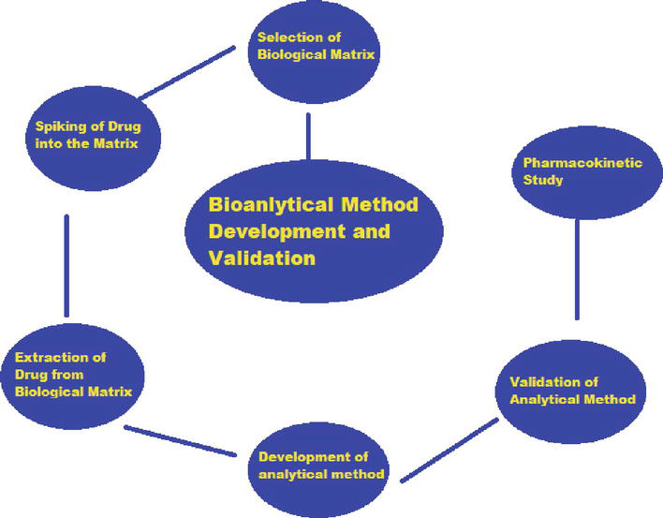
Figure of Analytical, Bioanalytical, Stability-Indicating Methods
Key Parts

Slide 32
Analytical Chemistry Problems and Solving Skills
Many problems in analytical chemistry begin with the need to identify what is present in a sample. This is the scope of a qualitative analysis, examples of which include identifying the products of a chemical reaction, screening an athlete’s urine for a performance-enhancing drug, or determining the spatial distribution of Pb on the surface of an airborne particulate. An early challenge for analytical chemists was developing simple chemical tests to identify inorganic ions and organic functional groups. The classical laboratory courses in inorganic and organic qualitative analysis, still taught at some schools, are based on this work.

Slide 33
PROBLEM SOLVING IN CHEMISTRY
First - Problem solving is what chemists do, regardless of whether they work in the area of synthesis, spectroscopy, theory, analysis, or the characterization of compounds.
Second, it was clear that individuals who were successful in chemistry courses either developed good problem solving skills — more or less on their own —or brought these skills to their chemistry courses.
Finally, it was obvious that we weren’t doing as good a job as we could in helping less successful students learn how to build problem solving skills.

Slide 34
PROBLEM SOLVING IN ANALYTICAL CHEMISTRY
The Analytical Approach can be broken into several steps.
1. Identify and define the problem
2. Design the experimental plan/procedure
3. Conduct the experiments to produce data relevant to the problem
4. Analyze the experimental data
5. Propose a solution to the problem
For more Details and Definition for the above steps refer to the Following Reference: Laitinen, H.A. 1966. the analytical approach to problem solving. Anal. Chem. 38, 1441.

Slide 35
The four simple steps we use are:
READ the question.
PLAN your approach.
SOLVE the problem.
CHECK your answer.
The steps for solving a numeric word problem are analyze, calculate, and evaluate.
Analyze.
Evaluate.
Calculate.
There are 8-Step Problem Solving Process
Step 1: Define the Problem. What is the problem? ...
Step 2: Clarify the Problem. ...
Step 3: Define the Goals. ...
Step 4: Identify Root Cause of the Problem. ...
Step 5: Develop Action Plan. ...
Step 6: Execute Action Plan. ...
Step 7: Evaluate the Results. ...
Step 8: Continuously Improve.

Slide 36
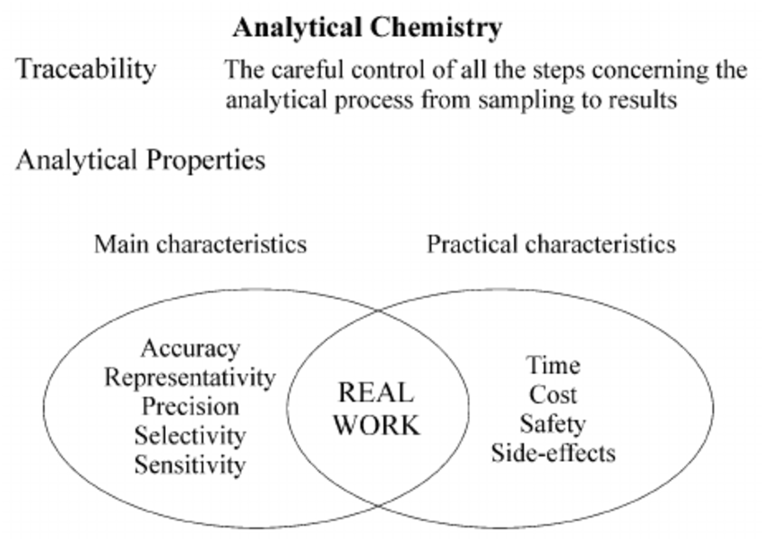
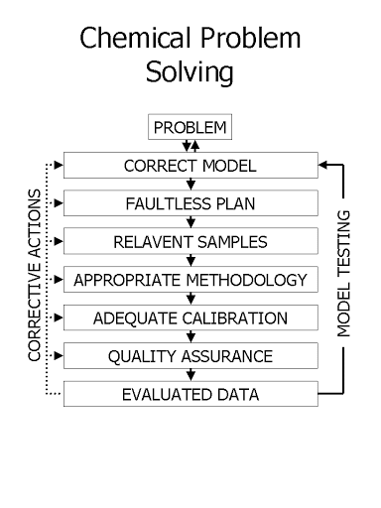
Images Examples of Problem Solving in analytical chemistry
Analytical Chemistry: A Tool For Problem Solving | Steps of A Chemical Analysis

Slide 37
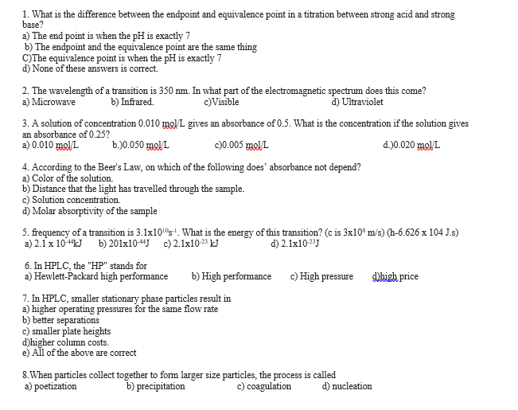
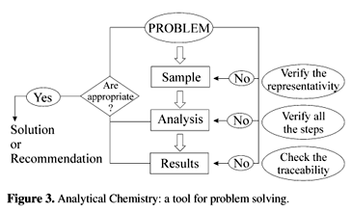
Examples of Problem Solving Images in analytical chemistry
An Integrated Approach of Analytical Chemistry | Solved: Help Me TO Solve This Analytical Chemistry MCQ

Slide 38
Analytical Problems
An Example of an Analytical Problem:
For solving, required the calculation of a data set’s basic statistical characteristics, such as its mean, median, range, standard deviation, or variance. For these kind of problems be sure you have access to a scientific calculator, a spreadsheet program, such as Excel, or a statistical software program, and that you know how to use it to complete these types of basic statistical calculations.
Calculate the Mean, Average, Median, the Range, the Standard Deviation, and the Standard Error of Mean (SEM), of the following 12 Data:
5.536, 5.539, 5.548, 5.549, 5.551, 5.552,
5.552, 5.554, 5.560, 5.632, 5.683, 5.684
Try solving this analytical problem as an exercise. Refer to equations given in previous Lecture.

Slide 39
What is an analytical assay?
An assay is an investigative (analytic) procedure in laboratory medicine, mining, pharmacology, environmental biology and molecular biology for qualitatively assessing or quantitatively measuring the presence, amount, or functional activity of a target entity (the analyte).
What is the first step in the analytical process?
When starting from a solid problem, the steps involved in the overall analytical process are:
(1) sampling and weighing;
(2) dissolution, leaching, or physical removal;
(3) clean-up;
(4) preconcentration;
(5) individual separation; and
(6) detection and data treatment.

Slide 40
Objectives of analytical chemistry
Three main objectives of analytical chemistry?
1. to develop an understanding of the range and uses of analytical methods in chemistry.
2. to develop an understanding of the broad role of the chemist in measurement and problem solving for analytical tasks.
3. to provide an understanding of chemical methods employed for elemental and compound analysis.

Slide 41
References for the Lecture topics from net
Is HPLC assay for drug substance a useful quality control attribute ...
www.researchgate.net › publication › 6294866_Is_HPLC...
Purity versus potency - Chromatography Forum
chromforum.org › viewtopic
Search for: What is purity and potency?
Stability Testing of Pharmaceutical Products - Journal of Applied ...
www.japsonline.com › admin › php › uploads › 409_pdf
Search for: How many types of stability are there in pharma?
Stability Testing of Pharmaceutical Products | Testing-Lab
testing-lab.com › 2017/07 › stability-testing
Search for: Why stability studies are required?

Slide 42
Assessing Shelf Life Using Real-Time and Accelerated Stability Tests
www.biopharminternational.com › view › assessing-shelf-...
Search for: How do you test accelerated stability?
Statistical Stability: Definition, Examples - Statistics How To
www.statisticshowto.com › statistical-stability
Drug Stability (pH Effect on Drug Stability)
cst-kh.edu.ps › staff › wp-content › uploads › 2010/10
Search for: How does pH affect drug stability?
Stability Testing of Cosmetics - Making Cosmetics
www.makingcosmetics.com › Stability-Testing-of-Cosmet...
Search for: How long is stability testing?
Climatic Zones for Stability Studies : Pharmaceutical Guidelineswww.pharmaguideline.com › 2010/12 › different-climatic...

Slide 43
ICH Guideline for stability study
What does ICH mean?
for Pharmaceuticals for Human Use
The International Council for Harmonization of Technical Requirements for Pharmaceuticals for Human Use (ICH) is unique in bringing together the regulatory authorities and pharmaceutical industry to discuss scientific and technical aspects of pharmaceuticals and develop ICH guidelines.
Which is correct ICH Guideline for stability study?
Testing Frequency
Frequency of testing should be sufficient to establish the stability characteristics of the drug product. Testing will normally be every three months over the first year, every six months over the second year and then annually. The use of matrixing or bracketing can be applied, if justified.
ICH Topic Q 1 A Stability Testing Guidelines: Stability Testing of New ...
www.pharma.gally.ch › ich
Search for: Which is correct ICH Guideline for stability study?

Slide 44
I HOPE YOU ENJOYED YOUR
ADVENTURES TO THE WORLD OF
DRUG QUALITY CONTROL
HAVE A SUCCESSFUL TRIP TO EXAMS!!!

