Slide 1




بسم الله الرحمن الرحيم
PHARMACEUTICAL ANALYSIS
AND
DRUG QUALITY CONTROL
PH483 Lecture # 1 18-01-2021
DR. Badr M. Al-Hadiya

Slide 2
COURSE CONTENT
  - General Introduction & Definitions
  - Principles of Pharmaceutical Quality Control
  - Analytical Criteria for Drug Quality Assessment
  - Statistical Methods for Analysis
  - Quality Control Methods Validation
  - Chemical Purity and its Control
  - Assay of Bulk and Pharmaceutical Preparation
  - Analytical Problems
  - Stability Indicating Method of Analysis
  - Others

Slide 3
General Introduction & Definitions
Pharmaceutical analysis is a broader term which can be defined in many ways. It is the series of processes that are used for identification, determination, separation, purification, and structure elucidation of the given compound used in the formulation of pharmaceutical products.
What is Pharmaceutical Quality Control?
The term quality control refers to the sum of all procedures undertaken to ensure the identity and purity of a particular pharmaceutical.
What is the role of quality control in pharmaceutical industry?
The main function of quality control is to test and verify the product quality against the predefined standards. ... Quality Control department functions for assuring the quality of all the batches manufactured, at every stage of manufacturing /processing Drug Products.

Slide 4
What is quality control analysis?
Quality control involves testing of units and determining if they are within the specifications for the final product. The purpose of the testing is to determine any needs for corrective actions in the manufacturing process. Good quality control helps companies meet consumer demands for better products.
What is quality control analysis?
Quality control involves testing of units and determining if they are within the specifications for the final product. The purpose of the testing is to determine any needs for corrective actions in the manufacturing process. Good quality control helps companies meet consumer demands for better products.
Which comes first QA or QC?
Quality assurance is a proactive process which starts even before the work on the deliverable has started, while quality control is a reactive process and its activity starts as soon as you start working on the deliverable.

Slide 5
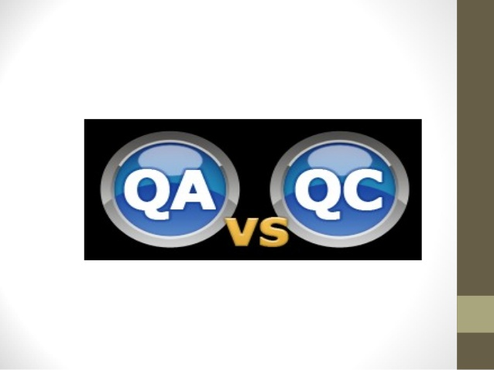
QUALITY CONTROL AND
QUALITY ASSURANCE
MEASURES IN PHARMACY

Slide 6
In order to maintain or enhance the quality of the offerings, manufacturers use Two Techniques: Quality Control (QC) and Quality Assurance (QA). These two practices make sure that the end products meets the quality requirements and standards defined for the product.
Somebody may ask: Are QA and QC same Terms?
The Answer is Big No. This both terms are effectively different.
Most of the time we use both terms randomly, hence to study and understand the difference between them is important.

Slide 7
Differentiation Between QA and QC
Let’s us Differentiate according to below points:
- Definition
- Focus on
- Goal
- How to Achieve
- Example
- Responsibility

Slide 8
DEFINITION: QUALITY CONTROL (QC)
• QC is a set of activities for ensuring quality in products. The activities focus on identifying defects in the actual products produced.
• Quality is the fitness of a product for purpose or use by patient. It refers to its features and characteristics like shape, dimension, composition, strength, finish and color.
• The Quality Control is “the systematic control of these variables encountered in manufacturing process which affect the excellence of the end product.”
• Also, Quality Control is “that technique or group of techniques of industrial management by means of which products of uniform acceptable quality are manufactured.”

Slide 9
DEFINITION: QUALITY ASSURANCE (QA)
• QA is a set of activities for ensuring quality in the process by which products are developed.
•QA ensures that products are consistently produced and controlled to the quality standards appropriate to their intended use.
• QA can be defined as "part of quality management focused on providing confidence that quality requirements will be fulfilled.“ The confidence provided by quality assurance is twofold—internally to management and externally to customers, government agencies, regulators, certifiers, and third parties.
• QA is a way of preventing mistakes and defects in manufactured products and avoiding problems when delivering products or services to customers; which ISO 9000 defines as "part of quality management focused on providing confidence that quality requirements will be fulfilled".

Slide 10
FOCUS ON QA and QC
- QA focuses on:
- It aims to prevent defects with a focus on the process used to make the product
- It is a proactive quality process
- It identifies weakness in processes to improve them.
- QC focuses on:
- It aims to identify and correct defects in the finished product
- It is a reactive process.

Slide 11
GOALS OF QA AND QC
- QA Goal:
It is to improve development and test processes so that defects do not arise when the product is being developed.
- QC Goal:
It is to identify defects after a product is developed and before it is released.

Slide 12
How to achieve QA and QC Goals
QA Goals:
- Establish a good quality management system and the assessment of its adequacy.
- Periodic conformance audits of the operations of the system.
- Prevention of quality problems through planned and systematic activities including documentation.
QC Goals:
- Finding and eliminating sources of quality problems through tools and equipment so that customer’s requirements are continually met.
- The activities or techniques used to achieve and maintain the product quality, process and service.

Slide 13
Quality Assurance of Pharmaceuticals
Pharmaceutical Quality Assurance may be defined as the sum of all activities and responsibilities required to ensure that the medicine that reaches the patient is safe, effective, and acceptable to the patient.
In the Pharmaceutical Industry, Quality Assurance (QA) is essential for ensuring that Pharmaceutical products are manufactured to a safe and consistent standard. ... QA professionals are responsible for instituting a range of practices that help guarantee a drug's Quality.

Slide 14
Pharmaceutical Quality Assurance in Pharmacy
A Quality Assurance Specialist should ensure that the final product observes the company's quality standards. In general, these detail-oriented professionals are responsible for the development and implementation of inspection activities, the detection and resolution of problems, and the delivery of satisfactory outcomes.

Slide 15
QA EXAMPLES and Responsibilities
QA – Example:
- A QA Audit تدقيق
- Process Documentation
- Establishing Standards
- Developing Checklist
- Conducting Internal Audit تدقيق داخلي
RESPONSIBLE FOR QA :
Everyone in the team involved in developing the
product is responsible for Quality Assurance

Slide 16
QC EXAMPLE and Responsibilities
QC - EXAMPLE:
- A QC review
- Performing Inspections
- Performing Testing.
Responsible For QC:
QC is usually the responsibility of a specific team
that tests the product defects.

