Slide 1
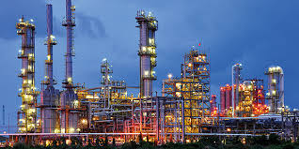




Petrochemicals-Lec:2
Baha I. Elzaki
: baha88@163.com
:+249112655046
: +249963702451
Chemical Engineering Department

Slide 2
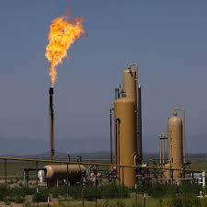
Primary Raw Materials for Petrochemicals
Contents
1
Introduction
2
Natural Gas
3
Crude Oils
4
Coal, Oil Shale, Tar Sand, and Gas Hydrates

Slide 3
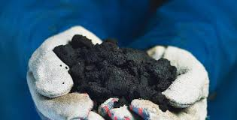
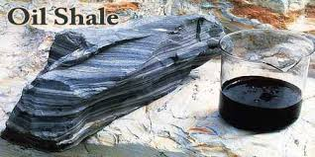
Introduction
In general, primary raw materials are naturally occurring substances that have not been subjected to chemical changes after being recovered.
Natural gas and crude oils are the basic raw materials for the manufacture of petrochemicals.
Coal, oil shale, and tar sand are complex carbonaceous raw materials
and possible future energy and chemical sources

Slide 4
Natural Gas
Natural Gad
Natural Gas Treatment Processes
Properties of Natural Gas
Natural Gas Liquids
Natural gas is a naturally occurring mixture of light hydrocarbons accompanied by some non-hydrocarbon compounds. It may found non-associated or associated with oil (Non-associated and Associated Natural Gases). Non-associated natural gas is found in reservoirs containing no oil (dry wells). Associated gas, on the other hand, is present in contact with and/or dissolved in crude oil and is coproduced with it.

Slide 5
The principal component of most natural gases is methane. Higher molecular weight paraffinic hydrocarbons (C₂-C₇) are usually present in smaller amounts with the natural gas mixture, and their ratios vary considerably from one gas field to another. Non-associated gas normally contains a higher methane ratio than associated gas, while the latter contains a higher ratio of heavier hydrocarbons.
The non-hydrocarbon constituents in natural gas vary appreciably from one gas field to another. Some of these compounds are weak acids, such as hydrogen sulphide and carbon dioxide. Others are inert, such as nitrogen, helium and argon. Some natural gas reservoirs contain enough helium for commercial production.

Slide 6
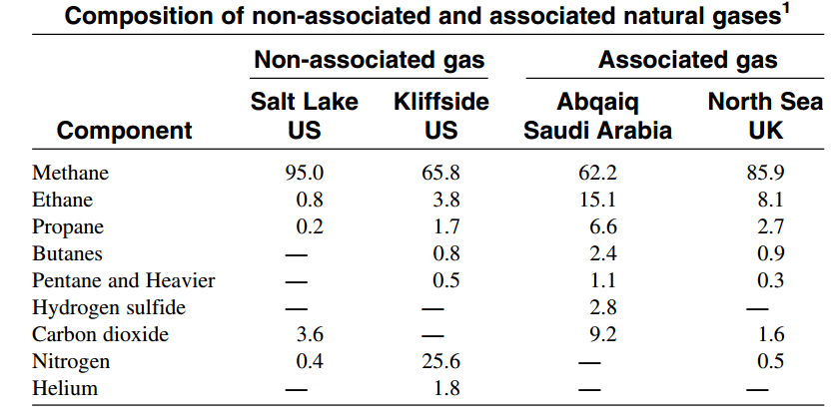
Non-associated and Associated Natural Gases
（三）内容的编纂
The table shows the analyses of some selected non-associated and associated gases.
1、资料的搜集

Slide 7
（三）内容的编纂
Higher molecular weight hydrocarbons present in natural gases are important fuels as well as chemical feedstocks and are normally recovered as natural gas liquids. For example, ethane may be separated for use as a feedstock for steam cracking for the production of ethylene. Propane and butane are recovered from natural gas and sold as liquefied petroleum gas (LPG). Before natural gas is used it must be processed or treated to remove the impurities and to recover the heavier hydrocarbons (heavier than methane).

Slide 8
Natural Gas Treatment Processes
Raw natural gases contain variable amounts of carbon dioxide, hydrogen sulphide, and water vapour. The presence of hydrogen sulphide in natural gas for domestic consumption cannot be tolerated because it is poisonous. It also corrodes metallic equipment
‘
‘
Carbon dioxide is undesirable, because it reduces the heating value of the gas and solidifies under the high pressure and low temperatures used for transporting natural gas. For obtaining a sweet, dry natural gas, acid gases must be removed and water vapour reduced. In addition, natural gas with appreciable amounts of heavy hydrocarbons should be treated for their recovery as natural gas liquids (NGL).
‘
‘

Slide 9
Acid Gas Treatment
（三）目标明确、重点突出原则
Acid gases can be reduced or removed by one or more of the following methods:
Chemical absorption
Physical adsorption using a solid adsorbent
Physical absorption using a selective absorption solvent
1
2
3
1
2
3

Slide 10
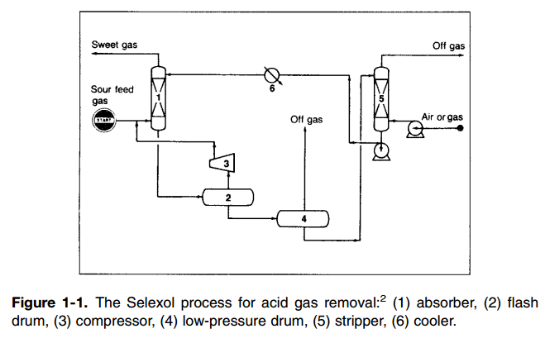
Physical absorption
Figure 1-1 shows the Selexol process.

Slide 11
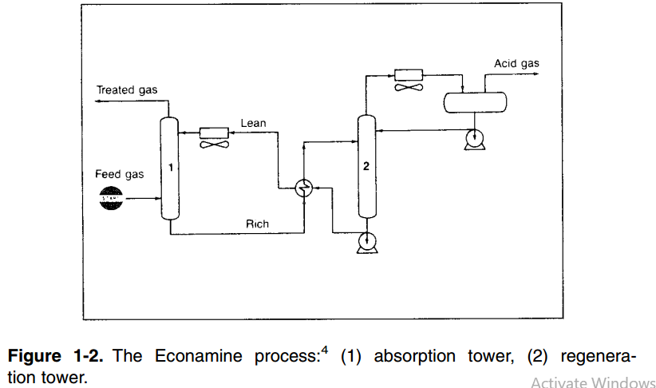
Chemical absorption
Figure 1-2 shows the Econamine process.

Slide 12
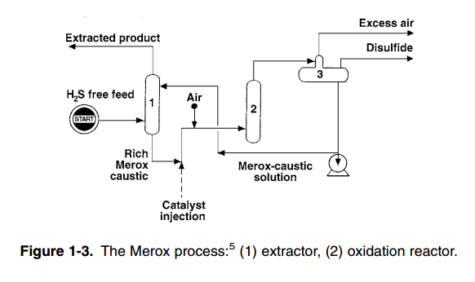
Chemical absorption
Figure 1-3 shows the Merox process.

Slide 13
Water Removal
（一）需求分析及目标确定
Moisture must be removed from natural gas to reduce corrosion problems and to prevent hydrate formation. Hydrates are solid white compounds formed from a physical-chemical reaction between hydrocarbons and water under the high pressures and low temperatures used to transport natural gas via pipeline. Hydrates reduce pipeline efficiency.
To prevent hydrate formation, natural gas may be treated with glycols, which dissolve water efficiently. Ethylene glycol (EG), diethylene glycol (DEG), and triethylene glycol (TEG) are typical solvents for water removal.

Slide 14
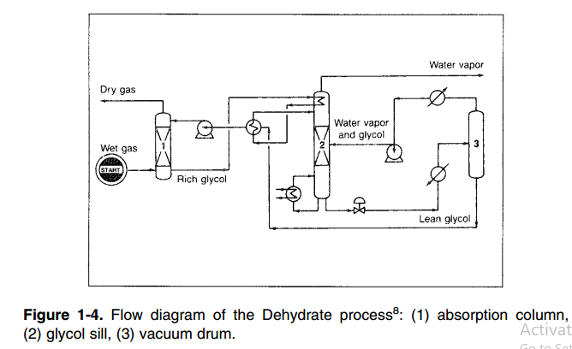
Water Removal
Figure 1-4. Flow diagram of the Dehydrate process

Slide 15
Natural Gas Liquids (NGL)
Natural gas liquids (condensable hydrocarbons) are those hydrocarbons heavier than methane that recovered from natural gas. The amount of NGL depends mainly on the percentage of the heavier hydrocarbons present in the gas and on the efficiency of the process used to recover them. (A high percentage is normally expected from associated gas.) Natural gas liquids are normally fractionated to separate them into three streams:
An ethane-rich stream,
which is used for producing ethylene.
1
2
Liquefied petroleum gas (LPG),
which is a propane-butane mixture.
3
Natural gasoline (NG) is mainly
constituted of C₅+ hydrocarbons and is
added to gasoline to raise its vapour
pressure. Natural gasoline is usually
sold according to its vapour pressure.

Slide 16
Liquefied Natural Gas (LNG)
After the recovery of natural gas liquids, sweet dry natural gas may be liquefied for transportation through cryogenic tankers. Two methods are generally used to liquefy natural gas: the expander cycle and mechanical refrigeration.

Slide 17
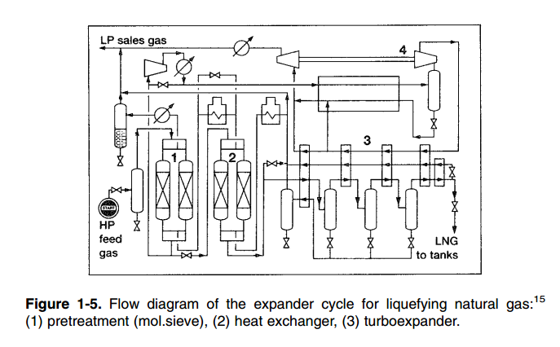
Liquefied Natural Gas (LNG)

Slide 18
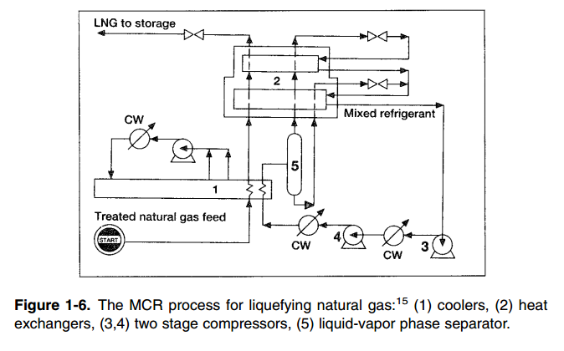
Liquefied Natural Gas (LNG)

Slide 19
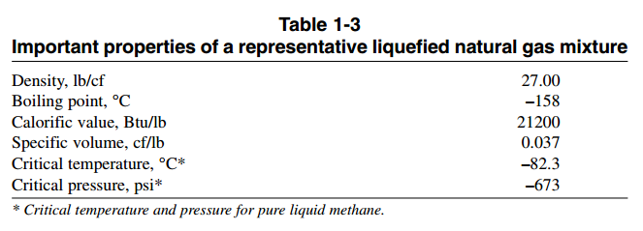
Liquefied Natural Gas (LNG)
Table 1-3 lists important properties of a representative liquefied natural gas mixture.

Slide 20
Properties of Natural Gas
Treated natural gas consists mainly of methane; the properties of both gases (natural gas and methane) are nearly similar. However, natural gas is not pure methane, and its properties are modified by the presence of impurities, such as N₂ and CO₂ and small amounts of unrecovered heavier hydrocarbons.

Slide 21
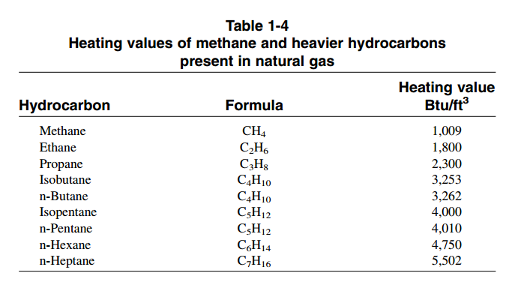
Properties of Natural Gas
An important property of natural gas is its heating value. Heating values of hydrocarbons normally present in natural gas are shown in Table 1-4. Natural gas is usually sold according to its heating values. The heating value of a product gas is a function of the constituents present in the mixture.

Slide 22
Crude Oil
Crude oil (petroleum) is a naturally occurring brown to black flammable liquid. Crude oils are principally found in oil reservoirs associated with sedimentary rocks beneath the earth’s surface. Although exactly how crude oils originated is not established, it is generally agreed that crude oils derived from marine animal and plant debris subjected to high temperatures and pressures. It is also suspected that the transformation may have been catalyzed by rock constituents. Regardless of their origins, all crude oils are mainly constituted of hydrocarbons mixed with variable amounts of sulphur, nitrogen, and oxygen compounds.

Slide 23
Crude Oil
Crude oils are refined to separate the mixture into simpler fractions that can be used as
fuels
lubricants
Crude oils
intermediate feedstock to the
petrochemical industries

Slide 24
Composition of Crude Oil
The crude oil mixture is composed of the following groups:
1
Hydrocarbon compounds (compounds made of carbon and hydrogen).
2
Non-hydrocarbon compounds.
Organometallic compounds and inorganic salts (metallic compounds).
3

Slide 25
Composition of Crude Oil
Hydrocarbon Compounds
The principal constituents of most crude oils are hydrocarbon compounds. All hydrocarbon classes are present in the crude mixture, except alkenes and alkynes. This may indicate that crude oils originated under a reducing atmosphere. The following is a brief description of the different hydrocarbon classes found in all crude oils.
1
Alkanes (Paraffins).
2
Cycloparaffins (Naphthenes)
Aromatic Compounds
3

Slide 26
Composition of Crude Oil
Non-hydrocarbon Compounds
Various types of non-hydrocarbon compounds occur in crude oils and refinery streams. The most important are the organic sulphur, nitrogen, and oxygen compounds. Traces of metallic compounds are also found in all crudes. The presence of these impurities is harmful and may cause problems to certain catalytic processes. Fuels having high Sulphur and nitrogen levels cause pollution problems in addition to the corrosive nature of their oxidization products.
1
Sulphur Compounds:
  (A) Acidic Sulphur Compounds. (B) Non-acidic Sulphur Compounds.
Nitrogen Compounds:
  (A) Basic Nitrogen Compounds. (B)Non-Basic Nitrogen Compounds.
2
3
Oxygen Compounds:
  (A) Acidic Oxygen Compounds. (B) Non-Acidic Oxygen Compounds.

Slide 27
Composition of Crude Oil
Many metals occur in crude oils. Some of the more abundant are sodium, calcium, magnesium, aluminium, iron, vanadium, and nickel. Vanadium and nickel are poisons to many catalysts and should be reduced to very low levels. Most of the vanadium and nickel compounds are concentrated in the heavy residues. Solvent extraction processes are used to reduce the concentration of heavy metals in petroleum residues.

Slide 28
Properties of Crude Oil
Density
Sulphur
Content
Properties of Crude Oil
Specific Gravity
and API Gravity
Pour
Point
Salt
Content
Ash
Content

Slide 29

Crude Oil Classification
Appreciable property differences appear between crude oils as a result of the variable ratios of the crude oil components. For a refiner dealing with crudes of different origins, a simple criterion may be established to group crudes with similar characteristics. Crude oils can be classified into:
  (1) Paraffinic—the ratio of paraffinic hydrocarbons is high compared to aromatics and naphthenes.
  (2) Naphthenic—the ratios of naphthenic and aromatic hydrocarbons are relatively higher than in paraffinic crudes.
  (3) Asphaltic—contain relatively a large amount of polynuclear aromatics, high asphaltene content, and relatively less paraffins than paraffinic crudes.

Slide 30
Coal, Oil Shale, Tar Sand and Gas Hydrates
Coal, oil shale, and tar sand are carbonaceous materials that can serve as future energy and chemical sources when oil and gas are consumed. The H/C ratio of these materials is lower than in most crude oils. As solids or semi-solids, they are not easy to handle or to use as fuels, compared to crude oils. In addition, most of these materials have high sulphur and/or nitrogen contents, which require extensive processing. Changing these materials into hydrocarbon liquids or gaseous fuels is possible but expensive. The following briefly discusses these alternative energy and chemical sources.

Slide 31
Coal
Coal is a natural combustible rock composed of an organic heterogeneous substance contaminated with variable amounts of inorganic compounds. Most coal reserves are concentrated in North America, Europe, and China.
Extensive research was done to change coal to liquid hydrocarbons. However, coal-derived hydrocarbons are more expensive than crude oils. Another way to use coal is through gasification to a fuel gas mixture of CO and H2 (medium Btu gas).
This gas mixture could be used as a fuel or as a synthesis gas mixture for the production of fuels and chemicals via a Fischer Tropsch synthesis route. This process is operative in South Africa for the production of hydrocarbon fuels.

Slide 32
Oil Shale
Oil shale is a low-permeable rock made of inorganic material interspersed with a high-molecular weight organic substance called “Kerogen.” Heating the shale rock produces an oily substance with a complex structure.
Tar Sand
Tar sands (oil sands) are large deposits of sand saturated with bitumen and water. Tar sand deposits are commonly found at or near the earth’s surface entrapped in large sedimentary basins. Large accumulations of tar sand deposits are few. About 98% of all world tar sand is found in seven large tar deposits.

Slide 33
Gas Hydrates
Gas hydrates are an ice-like material which is constituted of methane molecules encaged in a cluster of water molecules and held together by hydrogen bonds. This material occurs in large underground deposits found beneath the ocean floor on continental margins and in places north of the Arctic Circle such as Siberia. It is estimated that gas hydrate deposits contain twice as much carbon as all other fossil fuels on earth.

Slide 34

Thank
you
for
listening
Question

